Slide 1
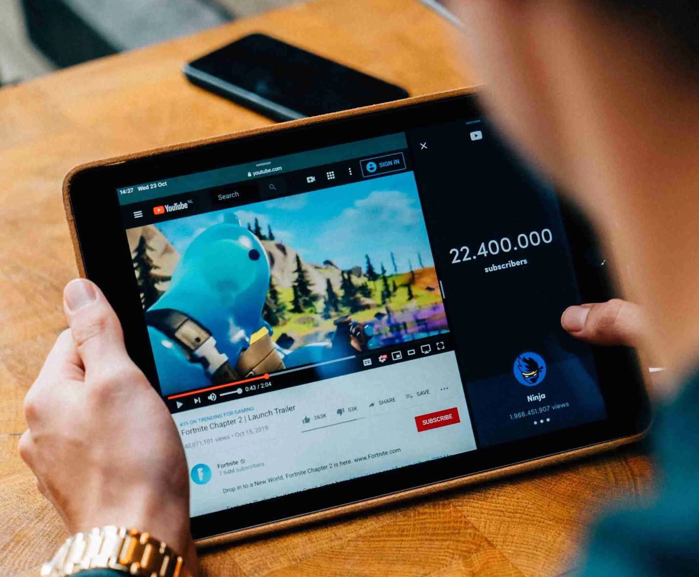

YouTube Trend Analysis
Group 2
Simon Gomes
Yichao Li
David Baldwin

Slide 2
Exploratory Research Background
Background:
Our project aims to analyse various datasets from YouTube and identify observable trends. The datasets analysed include the Top US Trending Videos from Kaggle for August to November of 2020, as well as three datasets obtained from the YouTube API: YouTube Search Items, YouTube Video Statistics, and YouTube Channel Statistics. The project encompasses trend analysis of user behaviours, video statistics, channel statistics, and category statistics, spanning the years 2019 and 2020. In particular, the review provides valuable insights into viewer trends during the strict COVID-19 lockdown in the US from March to June of 2020.
Research Questions to Answer:
Find out whether YouTube trends reflect societal events, such as quarantine challenges, vlogs, new music video releases, and video games?
As viewership of a video increases, it is typical to observe a corresponding rise in the number of likes, dislikes, and comments left by viewers. In essence, there tends to be a direct relationship between the level of viewer reactions and the size of the audience for a given video.
In light of the COVID-19 pandemic, it is apparent that there have been significant changes in YouTube viewer habits during 2020 when compared to 2019?
Information Coverage:
Top Five Liked Videos from August to November 2020
Most Published Videos per Category from August to November 2020
Top Trending Channels from August to October 2020
Relationship between View Count and Reactions per Category
Comparison Between the Top Two Categories: Music vs. Entertainment
Most Watched Videos in 2019
Most Watched Videos in 2020
The Most Viewed Quarantine Challenge Videos During Strict COVID Lockdown Findings and Observations Post - Mortem

Slide 3
Analytics Paradigm

Slide 4
Analytics Paradigm
Decompose the ask
Find out whether YouTube trends reflect societal events
Identify Data Source
The dataset used in this project comprises various sources, including the Top US Trending Videos on Kaggle spanning August to November 2020, as well as three datasets obtained from the YouTube API. These sources include YouTube Search Items, YouTube Video Statistics, and YouTube Channel Statistics.
Retrieve the Data
Assemble & Data Cleaning
Pandas Process with Pandas, we read the CSV file.
Analyse for data insights
Once we pulled the necessary data, we dropped the duplicate or irrelevant columns and reorganized the created data frames for readability. We also merged data frames based on the video ID and channel ID fields
Acknowledge Limitations
This project used a Kaggle CSV file and YouTube API to create the datasets regarding trends overtime based on the number of views. The CSV file solely focuses on US Trending data whereas the YouTube API expanded internationally.
Tell the Story
Focus on only US data set
We tried our best to connect the dots to find the insights with dataset.
Correlation among viewership, like and dislike, comments
Find out whether there is significant changes in YouTube viewer habits during 2020 when compared to 2019
Matplotlib Process Using the previously created PANDAS data frame we created additional layers to parse specific data per month, this included trending categories and user statistics.
API Process The dataset includes data gathered from videos on YouTube API that contained highest view counts in specific time periods.
Limited access to data
Time constraints
Technical error comes in while run the dataset using API in different time

Slide 5

Hypothesis 1: Find out whether YouTube trends reflect societal events

Slide 6
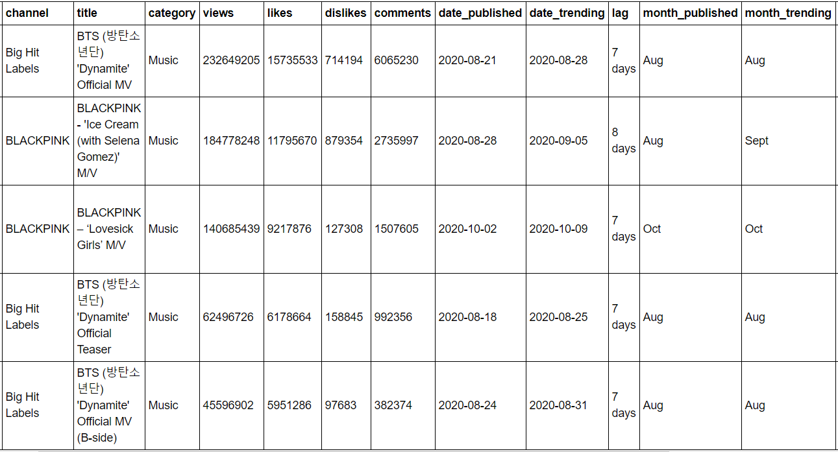
Top 5 Liked Videos From Aug to Nov 2020 The top five liked videos during this timeframe all fall in the music category; K-Pop groups seem to dominate this category.

Slide 7
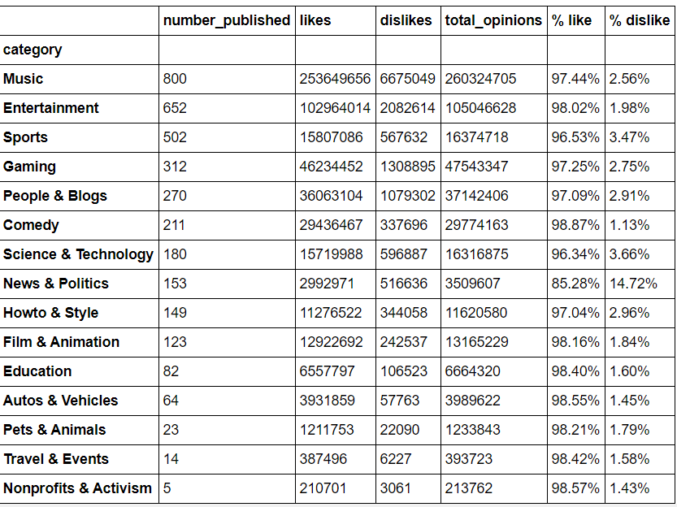
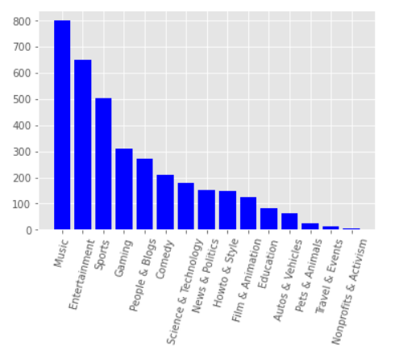
Most Published Videos per Category from August to November 2020 Music and entertainment publish the highest number of videos; surprisingly, Nonprofits and Activism had the least number of published videos with only five videos.

Slide 8
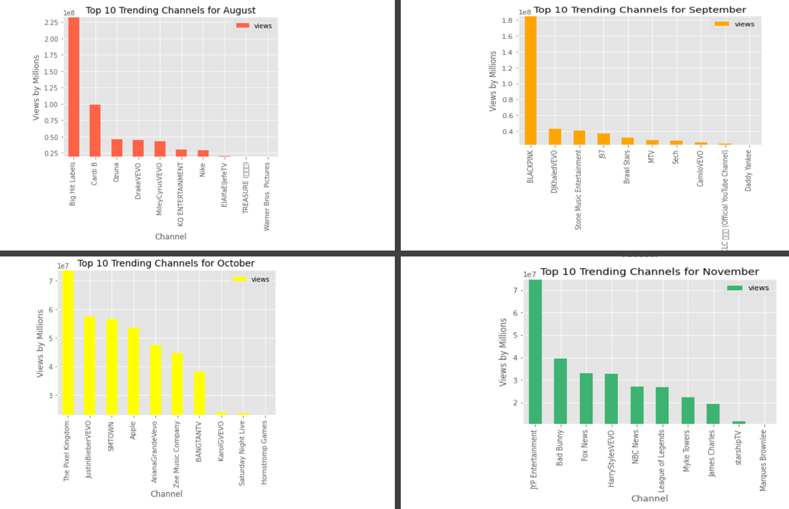
Top Trending Channels from August to October 2020 According to the top trending channel bar charts, the most popular channels in each month fall into either the music or entertainment categories. October is the exception as a gaming channel was the most popular as it reviewed the game Among Us.

Slide 9
Actual Result: YouTube trends aligned with societal
YouTube trends aligned with societal events accordingly based on the Top Five Liked Videos data frame and the most popular categories bar chart.
Music was the most popular category during this time and this was reflected as the top five videos were all related to K-Pop music groups, BTS and Blackpink. According to the top trending channel bar charts, the most popular channels in each month fall into either the music or entertainment categories; these are the top two popular categories overall:
August: Big Hit Labels was the most popular channel as BTS dropped music teasers and a video for their song, Dynamite.
September: Blackpink was the most popular channel as Blackpink dropped a song with Selena Gomez called Ice Cream.
October: The Pixel Kingdom, a gaming channel, was the most popular channel as it reviewed the hit game Among Us.
November: JYB Entertainment is the most popular channel in November so far as another K-Pop Group, Twice, released new music.
Societal events will align with YouTube Trends (ex. Quarantine challenges/vlogs, new music video releases, video games etc.)

Slide 10
Hypothesis 2: As the number of viewers grows, there will be a corresponding increase in viewer reactions.

Slide 11
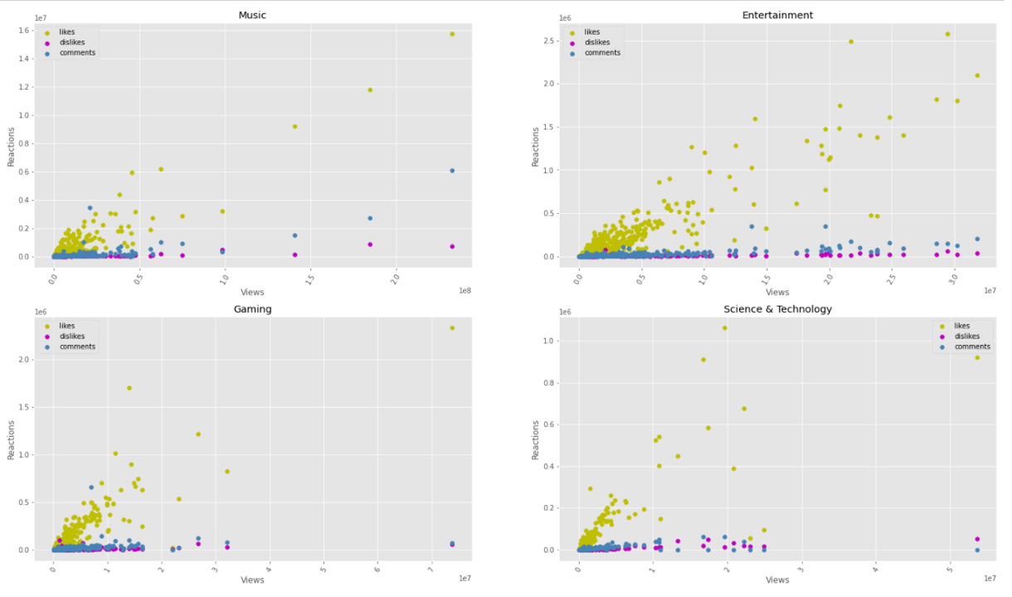
Relationship between View Count and Reactions per Category

Slide 12
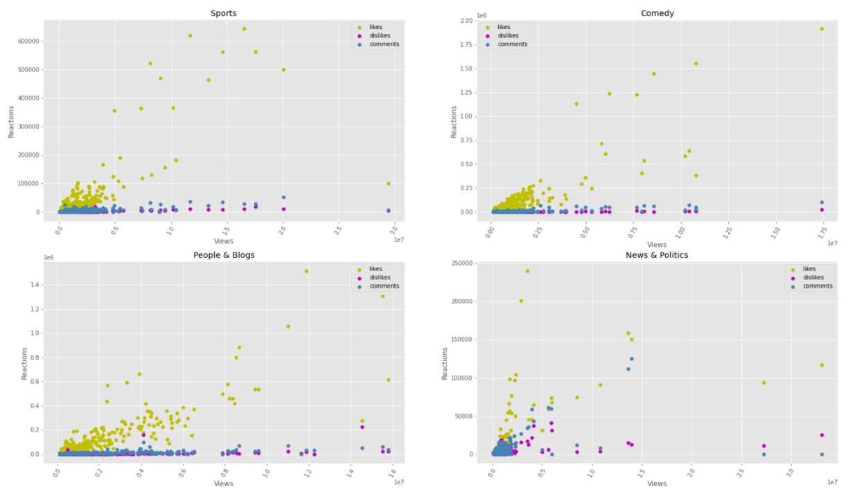
Relationship between View Count and Reactions per Category

Slide 13
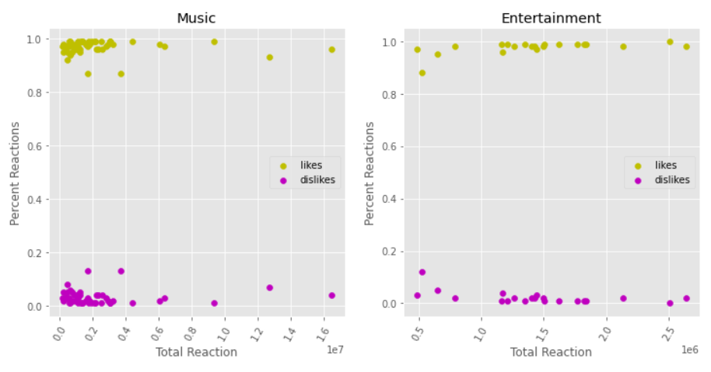
Comparison Between the Top Two Categories: Music vs. Entertainment
Music and entertainment are the top two popular categories and have very similar reactions in regard to the number of likes and dislikes.

Slide 14
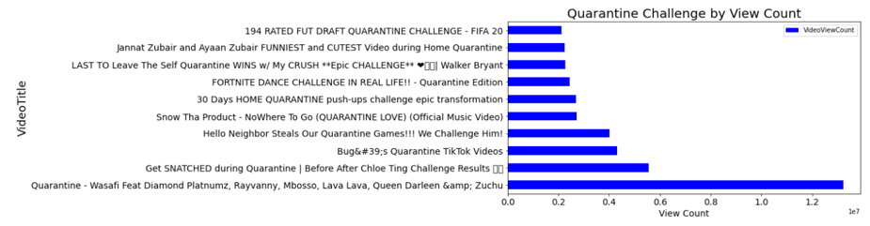
The Most Viewed Quarantine Challenge Videos During Strict COVID Lockdown
The horizontal bar graph depict the most viewed quarantine challenge videos created during lockdown. This data was pulled from the YouTube Search API dataset and the word cloud was generated from the comments.

Slide 15
The analysis disproved the hypothesis.
As view count increased, there was a decrease in viewer reactions (likes, dislikes, and comments).
Videos with lower view counts but recently published had a higher number of likes compared to dislikes and comments.
Users tend to interact with videos through likes rather than leaving comments.
In the top two categories (Music and Entertainment), the music category had a higher percentage of dislikes and likes when the view count was lower compared to the entertainment category.
Hypothesis 2:
If viewer count increases, viewer reactions will increase as well.

Slide 16
Hypothesis 3: Find out pre and during Covid viewership behavior

Slide 17
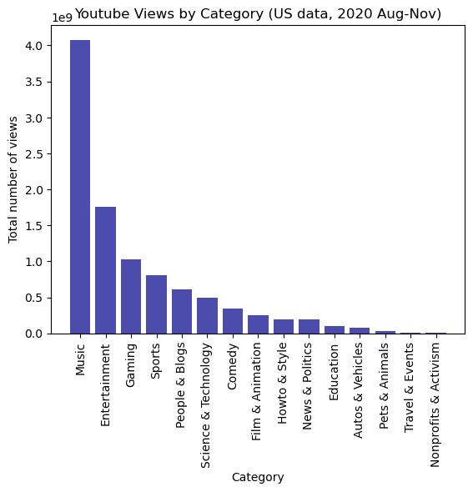
Top Channel Views
By Category
US data only (2020)
As shown earlier, music and entertainment were highest published videos. However, when the number of views were considered, music views were exponentially higher than other categories.
This suggests that relatively speaking, music videos accrued more views per video than other categories.
Interestingly, Travel and events views were relatively small in comparison – possibly as a result of global lockdowns.

Slide 18
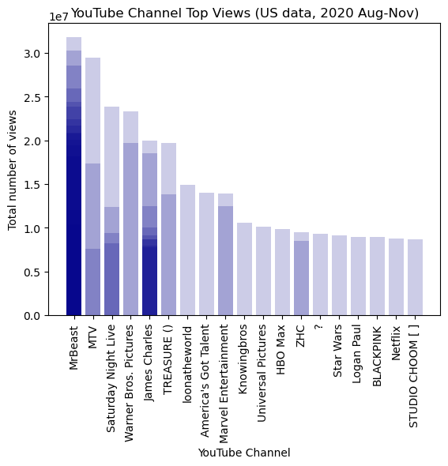
Top Channel Views
US data only (2020)
MrBeast – American. Focus on expensive stunts.
Est. 150million subscribers.
James Charles – American. Beauty influencer and makeup artist. 23.8million subscribers
TREASURE – South Korean band formed 2019. 6.95million subscribers
BLACKPINK– South Korean band formed 2009. Said to be ‘biggest girl band in the world’

Slide 19
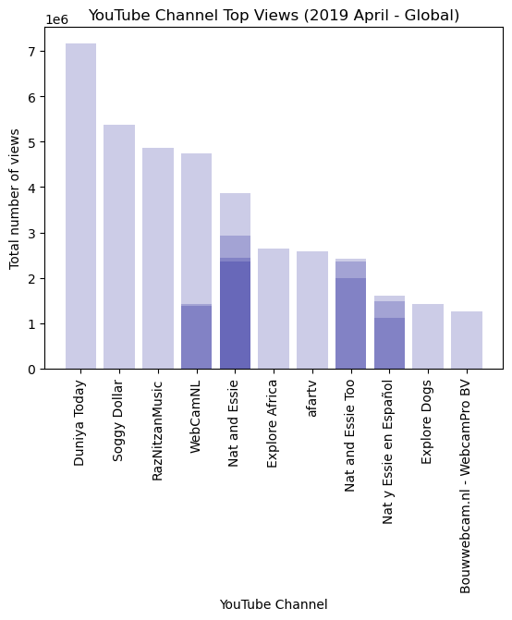
Top Channel Views Global data (2019) Top 50 titles viewed for videos published during April 2019, by channel
Duniya Today. Popular Indian news, sports and entertainment channel.
Soggy Dollar. Virgin Islands Paradise Bar Live Web cam

Slide 20
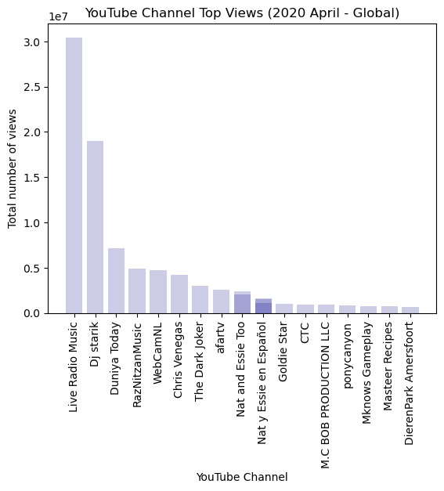
Top Channel Views Global data (2020) Top 50 titles viewed for videos published during April 2020, by channel
DJ Starik. Music producer
Chris Venegas. Music and content producer

Slide 21
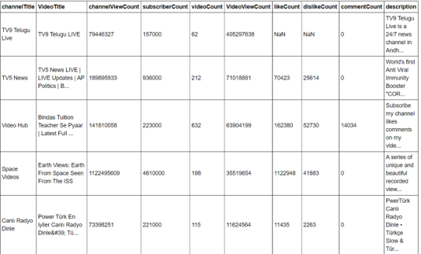
Most relevant Videos in 2019

Slide 22
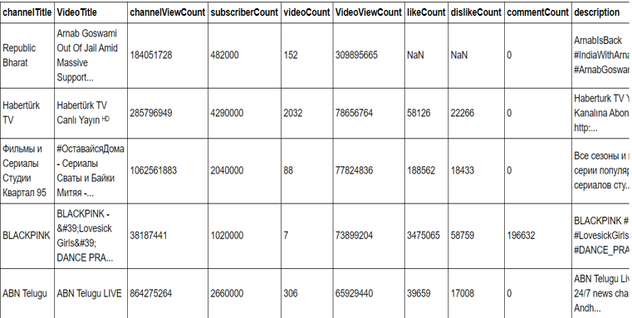
Most relevant Videos in 2020

Slide 23
Actual Result: YouTube trends aligned with societal
Based on the various data frames produced, the data suggests that YouTube viewing increased in 2020 compared to 2019.
The top five videos pulled from the YouTube API datasets in 2019 and 2020 were all largely international videos. The top five videos by ‘relevance’ for 2019 and 2020, are given below:
During the strict COVID lockdown from March to June, there were no obvious changes in viewer trends.
Music and Entertainment channels continued to be the most watched categories although there is some suggestion that different countries or regions may differ in this regard. For example, these categories form the most significant groups for views in the United States, but when international sites are considered, this appears to be less the case. In India, one of the largest viewed channels is Duniya Today – a very popular News, Sport and Entertainment channel. Other popular channels include:
Diamond Platinumz - Quarantine (Tanzanian Artist)
Chloe Ting - Get Snatched During Quarantine
Quarantine Tik Tok Videos
Hello Neighbors Steals our Quarantine Games
SnowthaProducts- Nowhere to Go (Quarantine Love) (song created by a Mexican/American artist and rapper)
In 2019, the top five videos:
Telegu News
TV5 News - Telegu News
Video Hub
Earth Views from Space
Turkish TV video
In 2020, the top videos:
Republic Bharat - Indian News
Haberturk TV - Turkish
Russian TV Show
Blackpink - Dance Practice
ABN Telegu News
Compared to 2019, YouTube viewing will increase in 2020. The lockdown will not affect the viewer trends because trends will remain consistant regardless social circumstances.

Slide 24

Limitations

Slide 25
Limitations
Due to time constraints, we focus on only on US market and ignore the response of rest of the world.
Due to the large datasets, with both the CSV and YouTube API, it was difficult to create a narrative for this project. The team had to figure out what data we wanted to pull and how we could connect the CSV and YouTube API datasets to form a bigger picture. We had a few meetings to discuss the overall importance and what the ultimate purpose was with our findings. All in all, it took time to figure out why we wanted this data and how it could prove useful for the YouTube community, whether that be investors or creators themselves.
Another difficulty involved reading the API and performing the API calls itself. It was a challenge to repeatedly call the API without going over the quota. There are only so many requests we could do and we had to implement another method that allowed us to continue our analysis without overextending our API limit.
Finding a commonality between the data frames in order to merge them effectively was another challenge. Some video IDs and channel IDs were actually dropped during the merge due to duplicates and irrelevancy.
Lastly, it was difficult to set the appropriate axes' values for our charts. For a few charts, Billy and Desiree had to manually input the limits in order to maintain consistency and display the correct values. Future Possibilities If we had two more weeks to work on this project, we would have conducted the following analysis:
We are also interested in learning how to export large datasets from the csv in order to compare daily statistics between 2019 and 2020, but we are not sure how to export such large datasets.
It would be interested to predict subscriber count for trending channels. Is it possible forecast this number with the provided datasets?
Comparison between negative and positive comments. Which categories receive the largest negative reactions based on the comments. Is it possible to track the negative and positive comments in a effective way? Possibly use a word count for a comment section in the most popular/least popular videos in a given category.

Slide 26
Limitations
YouTube is one of the largest online server and database providers in the world. Consequently, a limited dataset was chosen for initial analysis – video analysis for United States, during COVID, and for the period August through November 2020.
Data Acquisition:
The Google API enforces data quotas. The first challenge was the repeated need to call the API without exceeding the quota limit. Other methods were used to continue analysis without exceeding the API limit. A previously constructed dataset from YouTube was identified in Kaggle and this was used to undertake some of the initial analysis. Data from the YouTube API was investigated as part of the final analysis.
Data Preparation and Analysis:
Finding a commonality between the data frames in order to merge them effectively was another challenge. Some video IDs and channel IDs were actually dropped during the merge in order to improve the merging of datasets. Identification and removal of duplicated data was made more difficult by the fact that videos frequently were published or viewed under slightly different title names, on different channels or other variations. This lack of consistent naming and data structure made cleaning, classifying and grouping data extremely difficult.
Data Interpretation and Discussion:
Some of the results obtained from the analysis were unexpected. In particular, data from a representative dataset from April 2019 and April 2020 appear to show very high view counts for channels that seem esoteric or unusual. Further analysis and exploration of this data may assist in determining if the results observed are accurate, or represent a coding error, selection bias or other problem.
Lastly, it was difficult to set the appropriate axes' values for our charts. For a few charts, Billy and Desiree had to manually input the limits in order to maintain consistency and display the correct values. Future Possibilities If we had two more weeks to work on this project, we would have conducted the following analysis:
We are also interested in learning how to export large datasets from the csv in order to compare daily statistics between 2019 and 2020, but we are not sure how to export such large datasets.
It would be interested to predict subscriber count for trending channels. Is it possible forecast this number with the provided datasets?
Comparison between negative and positive comments. Which categories receive the largest negative reactions based on the comments. Is it possible to track the negative and positive comments in a effective way? Possibly use a word count for a comment section in the most popular/least popular videos in a given category.

Slide 27

THANK YOU

